Slide 1

Risk Profiling Predictive Analysis
Joseph Alexius Tapang

Slide 2
1. Introduction
Overview
This project is an extension of the automated investment questionnaire that aims to provide assistive predictive analysis as additional feature that the financial advisor can use.
Problem and Benefit
Having access to predictions based from statistical datasets will provide insights and informed data-driven decisions. This project would address the problem through the following goals:
Provide a facility to perform investment risk assessment analysis based from a dataset.
Predict the risk assessment based from client information and existing dataset information.

Slide 3
2. Methodology
Approach
Dataset used: USA Survey of Consumer Finances
Tools Used:
Dev Tool : VS Code
Programming Language: Python
Libraries: NumPy | Pandas | Matplotlib | Seaborn | Sklearn | Streamlit
Framework: CRISP-DM methodology
Technique: Predictive Analytics

Slide 4
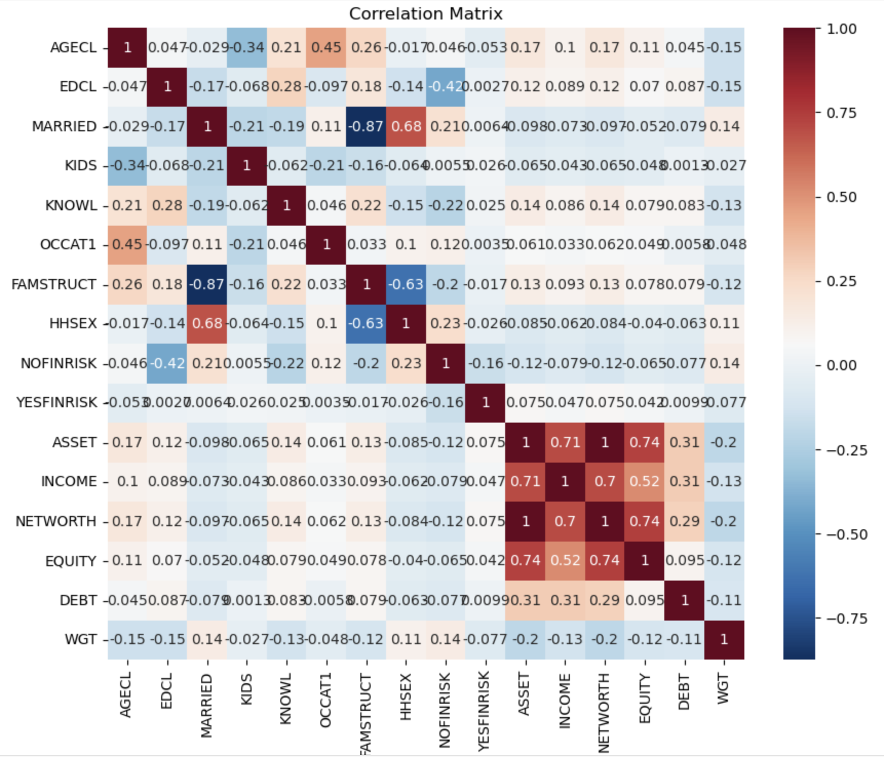
3. Key Findings & Analysis
Data Insights
22,795 rows and 357 columns.
Duplicates: Respondent ID (YY1) duplicated
five times using multiple imputation techniques
from the data source.
Missing values: No missing values observed.
Correlations:
Positive
INCOME, NETWORTH, ASSET, EQUITY (strong)
DEBT to INCOME, NETWORTH and EQUITY (moderate)

Slide 5
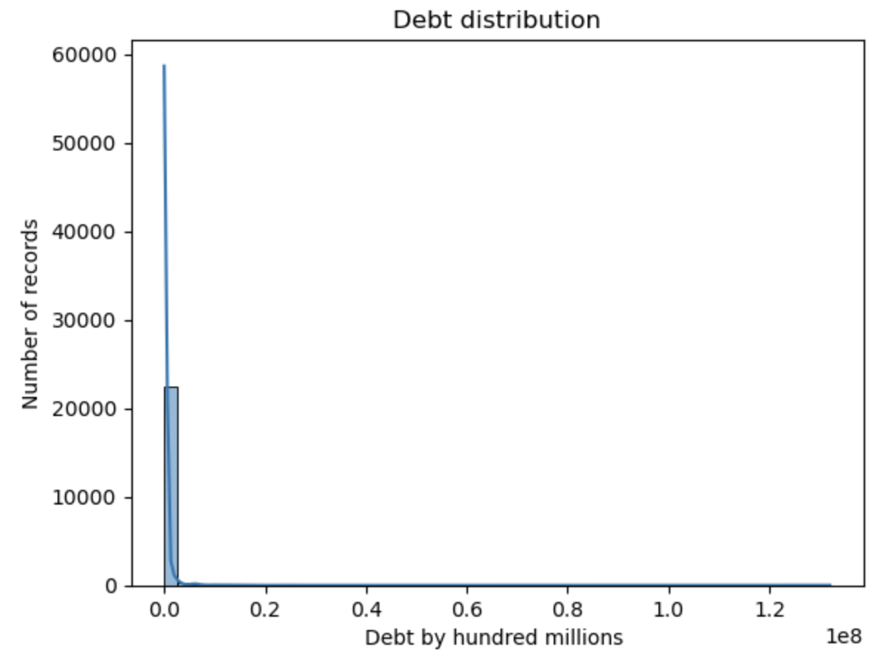
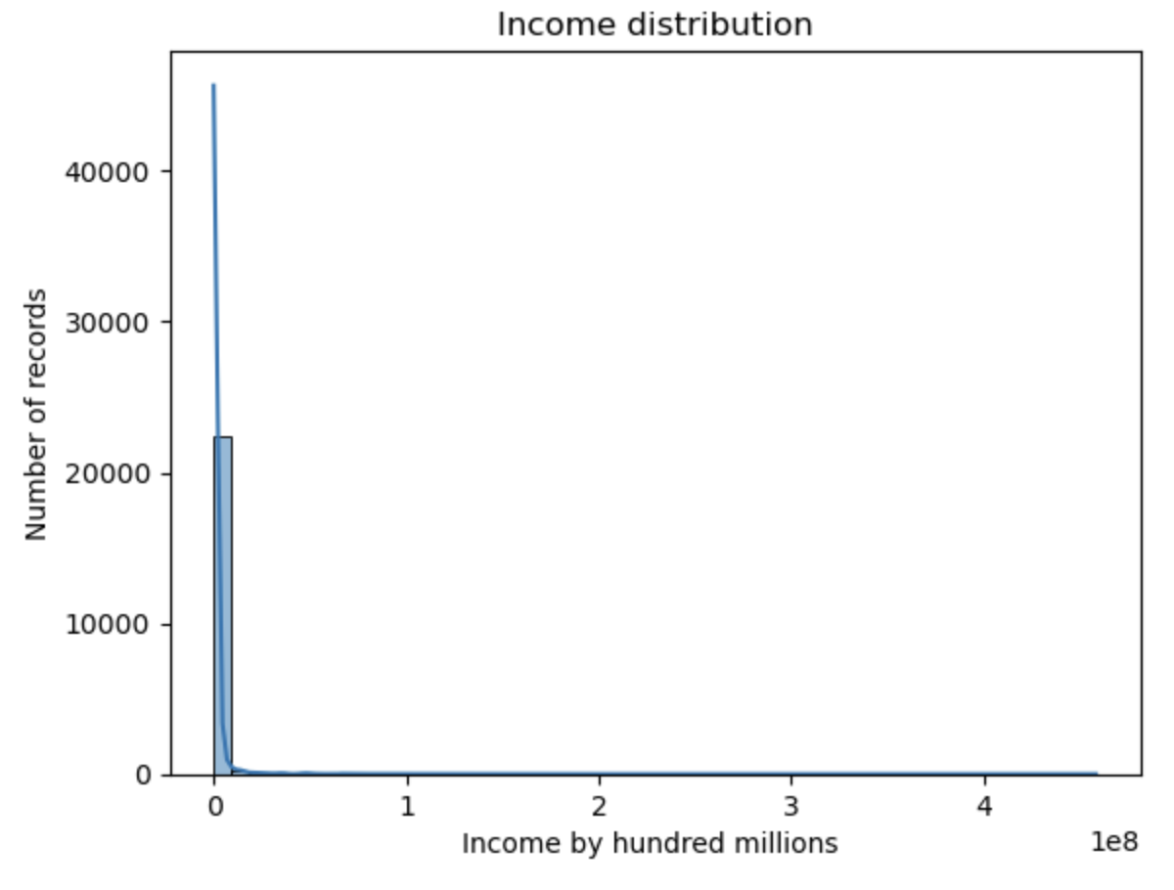
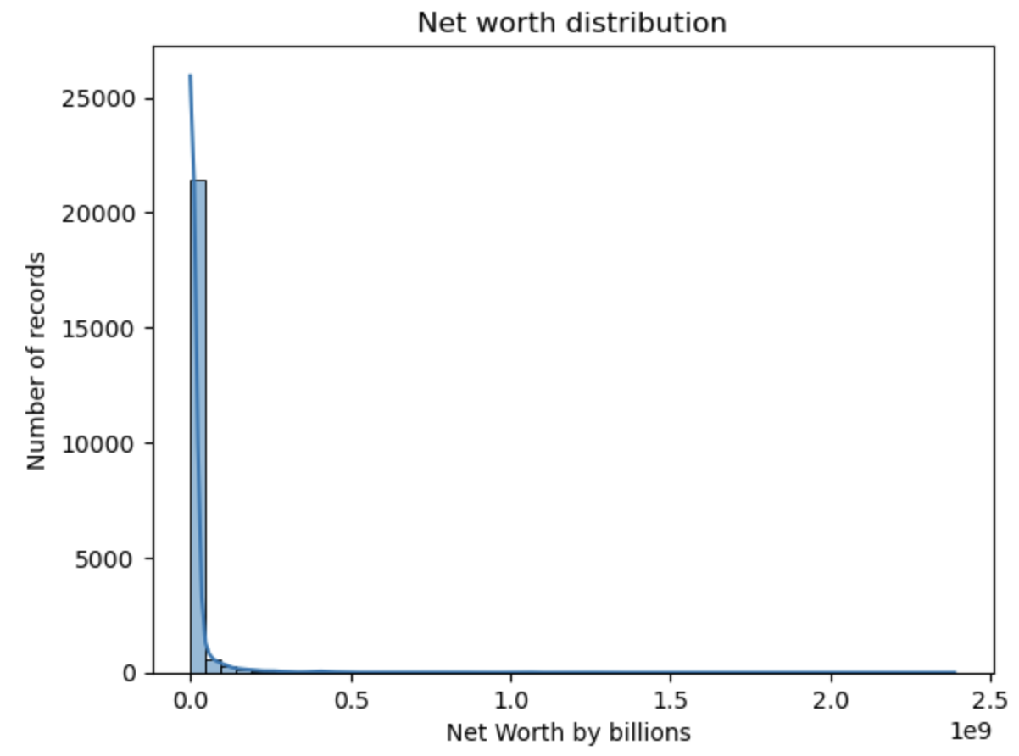
3. Key Findings & Analysis
OCCAT1 (Occupational Category) to AGECL(Age Class) and EDCL(Education Class) (moderate)
Negative Correlation
EDCL (Education Classification) to NOFINRISK (No Financial Risk) (moderate)
KNOWL (Financial Knowledge) to NOFINRISK (No Financial Risk) (moderate)
Skewness:
Net worth (right skewed)
Income (right skewed)
Debt (right skewed)

Slide 6
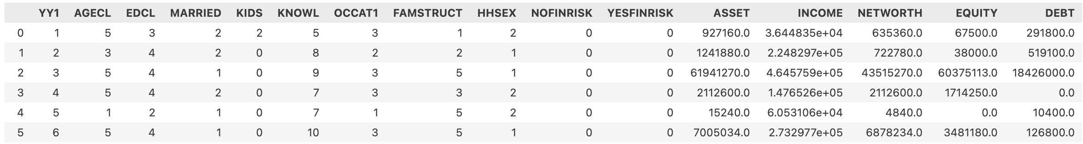
3. Key Findings & Analysis
Feature Selection and Engineering
Selected Key Attributes
YY1 | AGECL | EDCL | MARRIED | KIDS | KNOWL | OCCAT1 | FAMSTRUCT | HHSEX | NOFINRISK | YESFINRISK | ASSET | INCOME | NETWORTH | EQUITY | DEBT

Slide 7
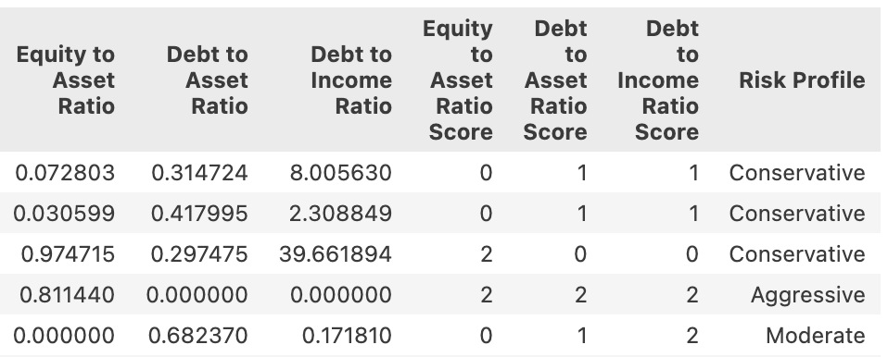
3. Key Findings & Analysis
Derived Attributes
Knowledge Group (categorical)
Metrics
Equity to Asset Ratio (numerical)
Debt to Asset Ratio (numerical)
Debt to Income Ratio (numerical)
Equity to Asset Score (numerical)
Debt to Asset Ratio Score (numerical)
Debt to Income Ratio Score (numerical)
Risk Profile (categorical)

Slide 8
3. Key Findings & Analysis
Interpretation of findings:
Ratios converted as weights (scores) for risk profiling.
Risk profiling matrix
Metric | Criteria and Score
 | 0 | 1 | 2
Equity to Asset Ratio | < 0.30 | > 0.30 and < 0.70 | > 0.70
Debt to Asset Ratio | > 0.40 | < 0.40 and > 0.10 | < 0.10
Debt to Income Ratio | > 0.40 | > 0.20 and < 0.40 | < 0.20
Formula | Total Score | Risk Profile
Equity to Asset Ratio + Debt to Asset Ratio + Debt to Income Ratio = Total Score | < 3 | Conservative
 | >= 3 | Moderate
 | < = 5 | Aggressive

Slide 9
4. Challenges & Solutions
Challenges | Solutions
No direct related data source available since financial data is confidential. | Referred to anonymized Survey of Consumer Finances that contains relevant information.
No direct attributes available in dataset to help in prediction. | Derive attributes to form as metrics needed by the model for prediction.
Dataset contains numerical values that is not aligned with classification target. | Conform values into bins as categorical values.

Slide 10
5. Demo

